Slide 1

Capstone Project – Exploring Helsinki Neighborhood
Using foursquare Data
By Anoogna Suresh Babu

Slide 2
Introduction/ Business Problem
An international travel agency which is established in many cities of the world is looking to expand its arrangements in Helsinki, Finland.
They need information on the hotels, restaurants, pubs, cafes, etc. along with the transport facilities available, viz, bus lines, train lines, etc.
To make the travel more convenient, information about emergency services is also provided.
With this information the travel agency can plan better and provide better services to their customers.

Slide 3
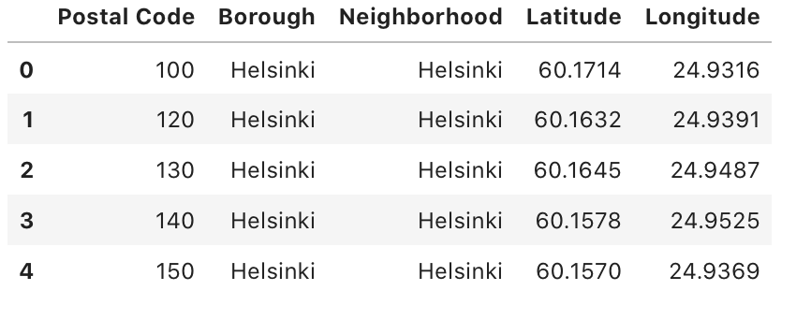
Data
The data for the given problem is taken from GeoNames. The Postal Code data for Finland is converted to .csv format. It is filtered to include only the required columns – Postal Code, Borough (Province), Neighborhood (Community), Latitude and Longitude. This is updated to a dataset. The following image shows an example of the dataset.

Slide 4
Once this dataset is ready, FourSquare data is used in order to explore the neighborhood of Helsinki. Folium is used to create the required maps.
Foursquare is used to get relevant information of locations of hotels, restaurants, pubs, places to visit, etc.

Slide 5
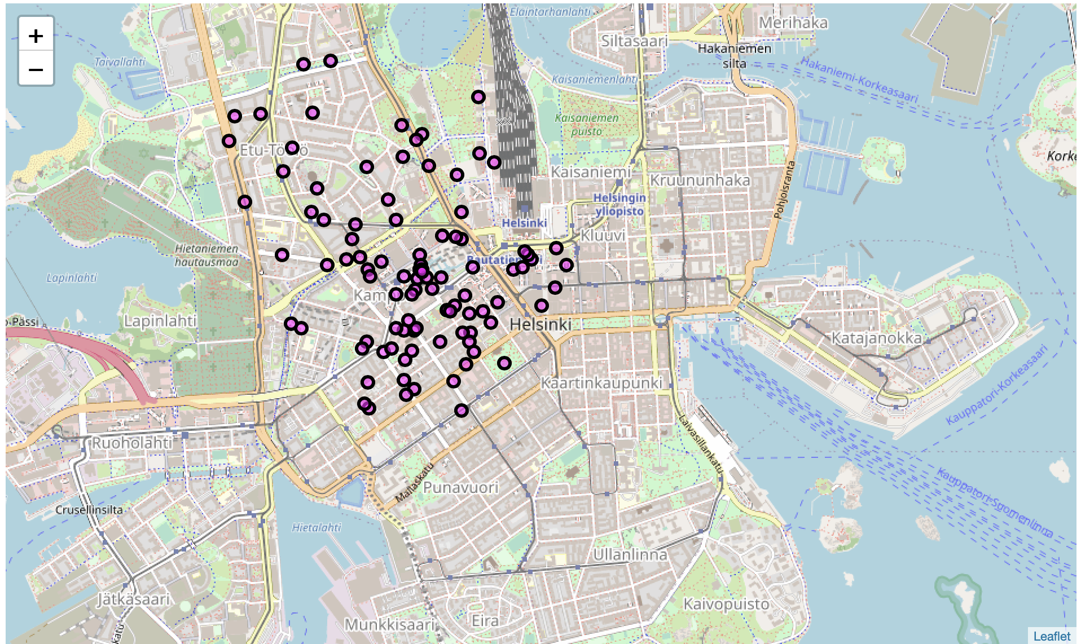
Methodology
Client ID and Client Secret are used to access the FourSquare API.
We then send a request to obtain the top 100 locations within a radius of 1000.
From the results’ list, we see that the top locations include Museums, Restaurants, Hotels, Cafes, etc. Hence, we will try to explore more into these categories.

Slide 6
We obtain list of locations of the following:
Hotels
Restaurants
Cafes
Museums
Gift Shops
Pubs
Parks

Slide 7
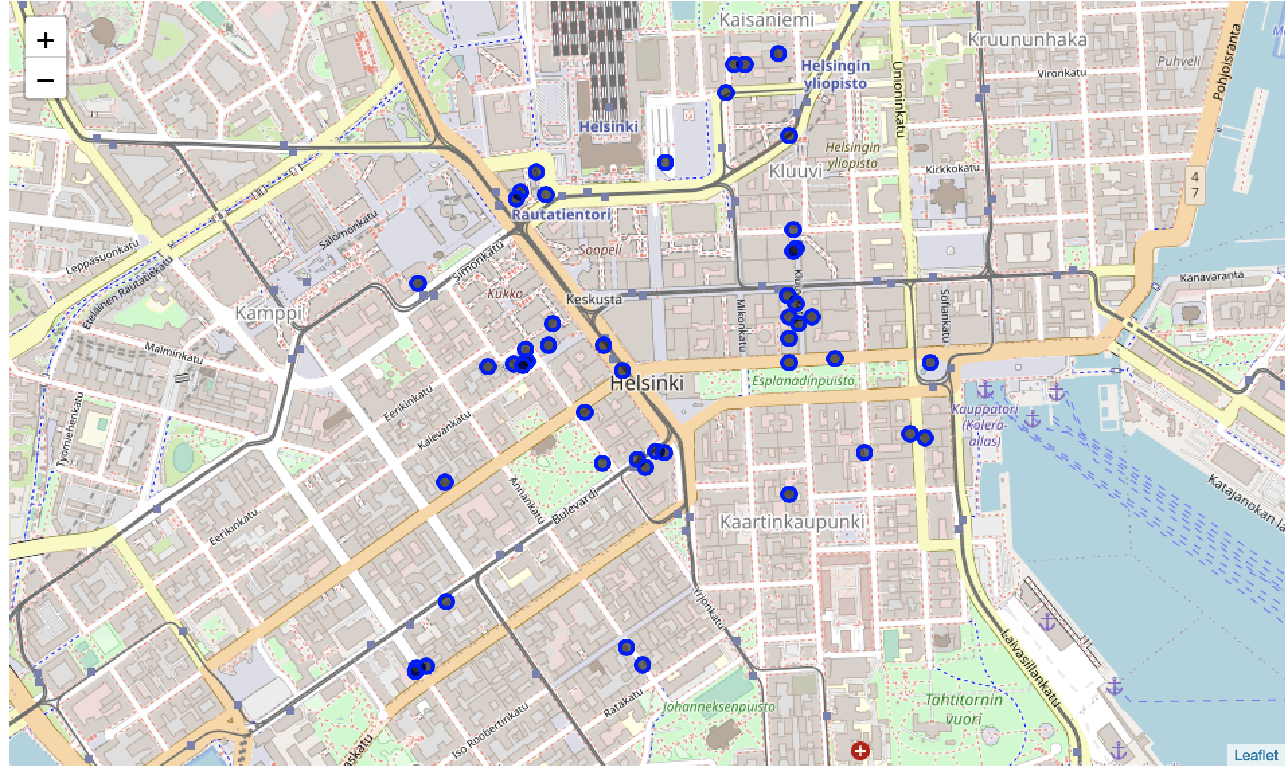
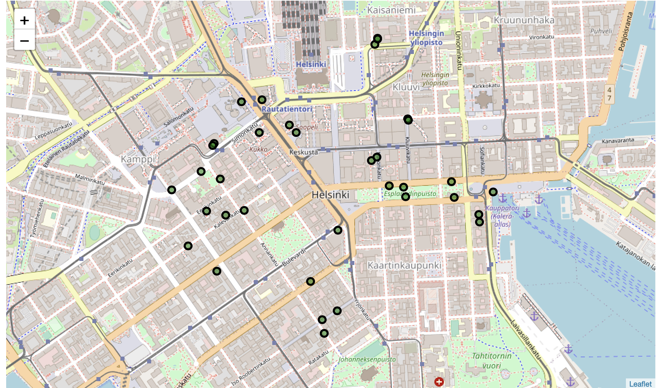
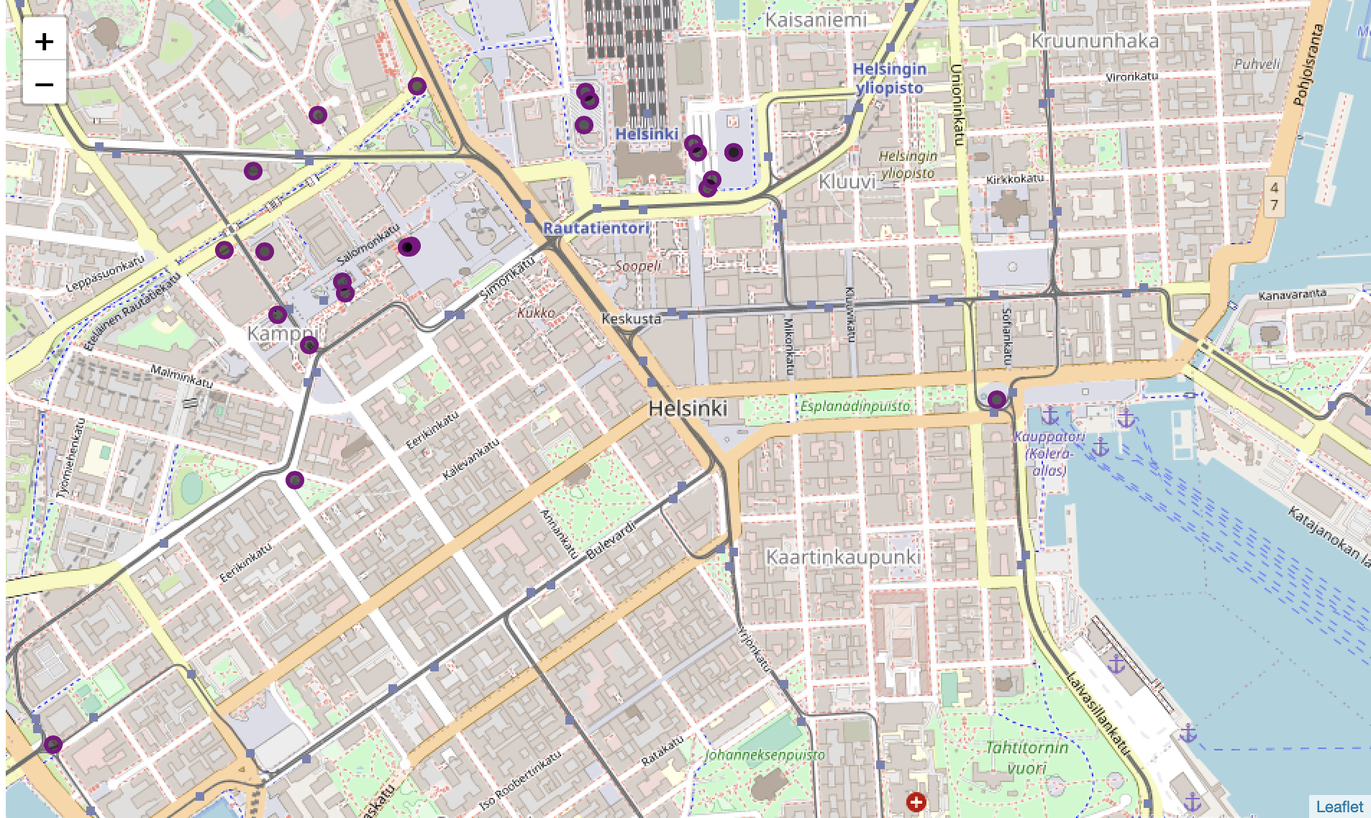
Results A few examples of the results are displayed below
Map displaying Hotels
Map displaying Restaurants
Map displaying Bus Lines

Slide 8
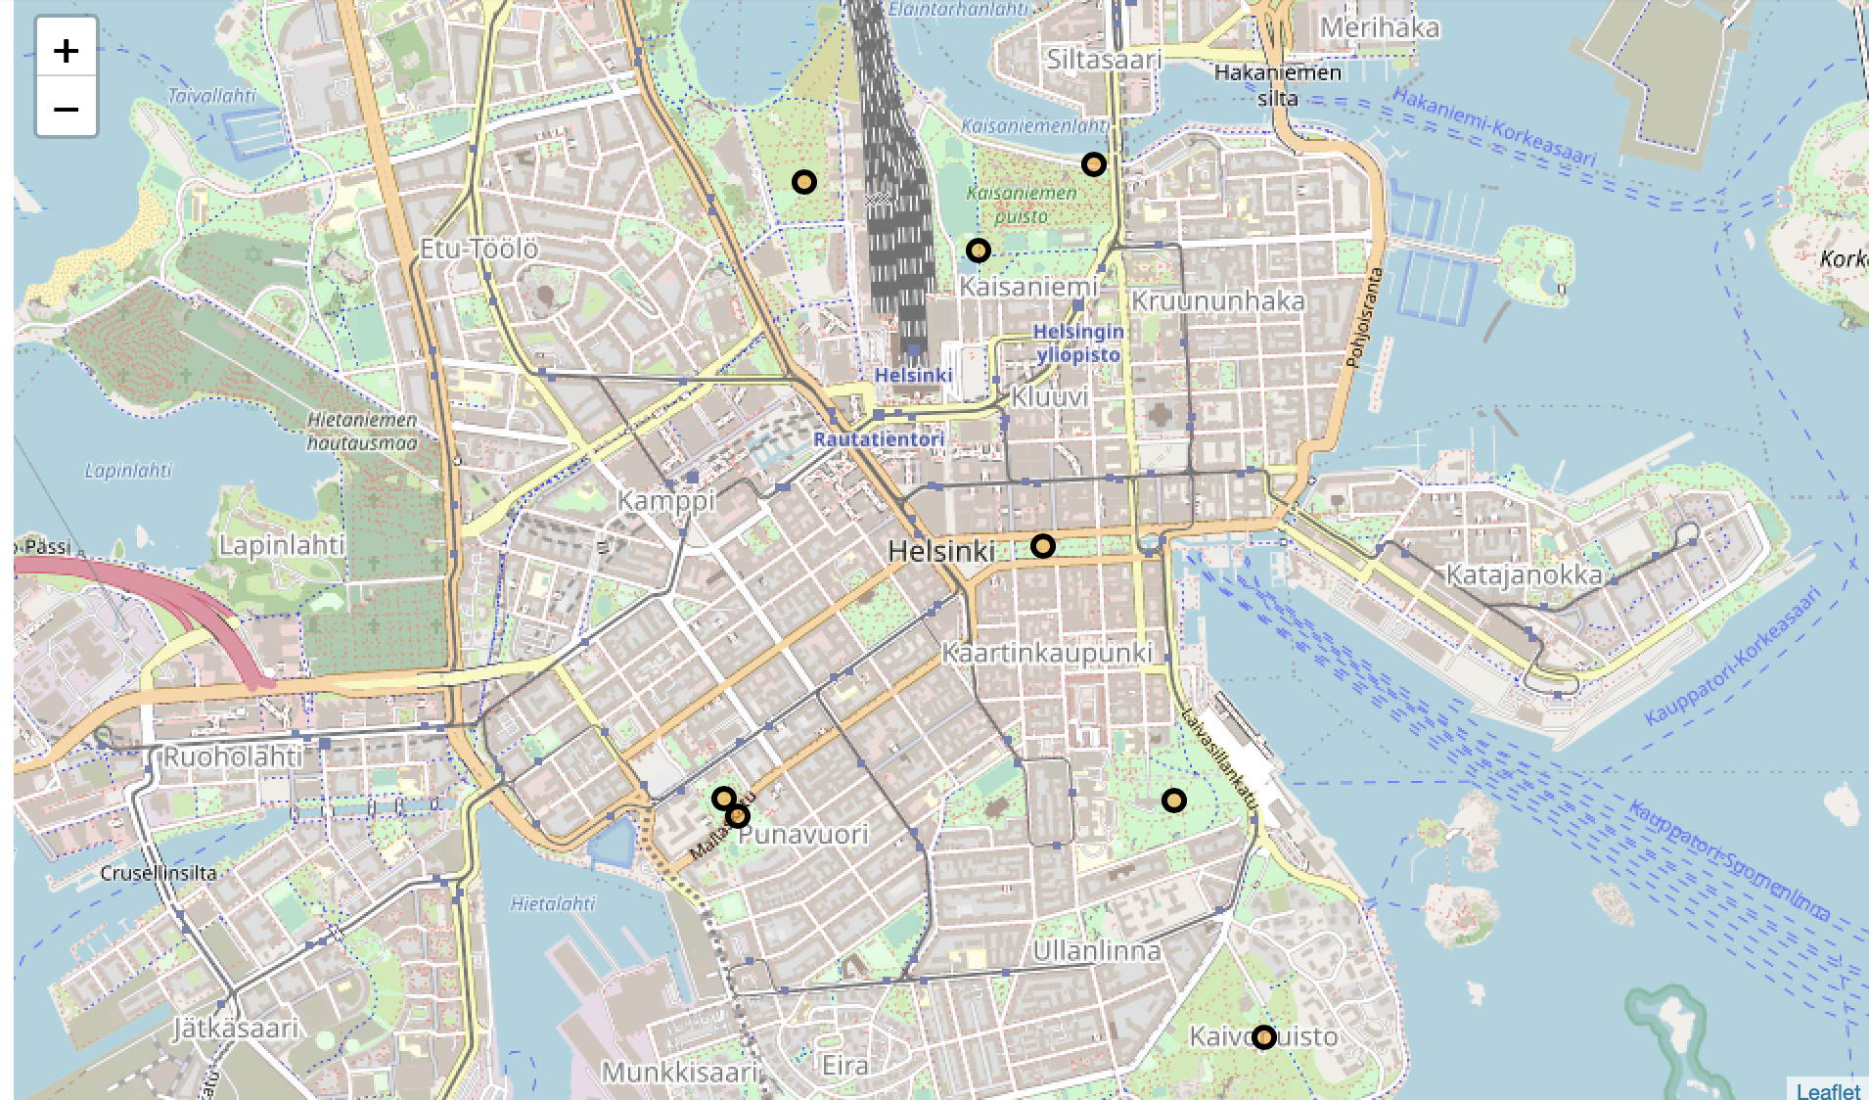
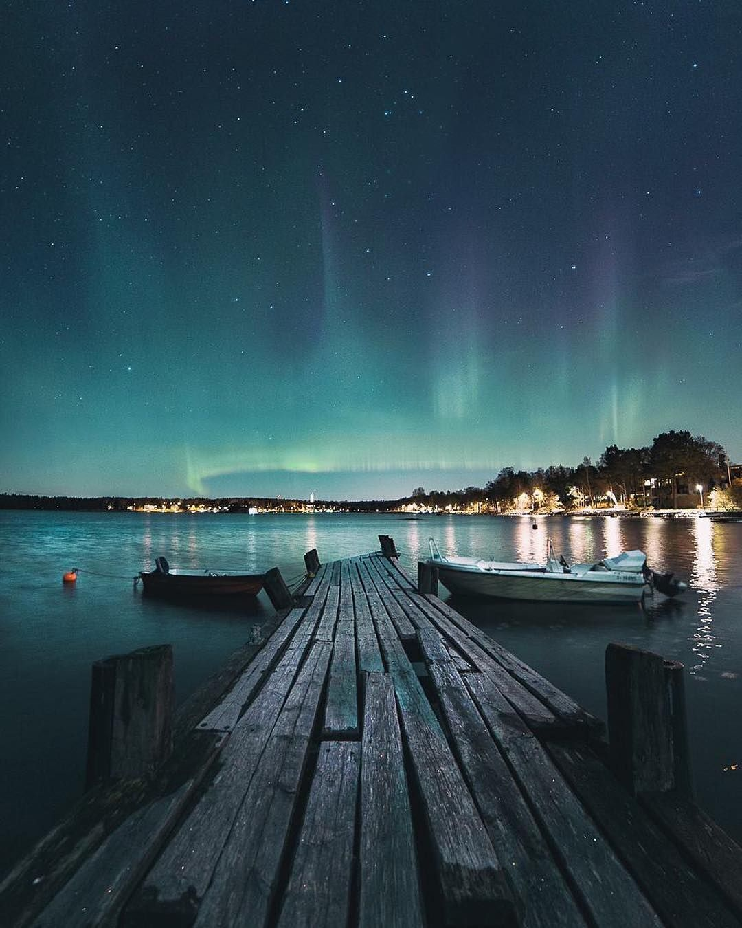
An example of Parks Category is shown below. Northern Lights can be observed here
Image from Google Search Results

Slide 9
Similarly Transport Facilities are listed :
Bus Lines
Metro Lines
Boat/Ferry Rides
Also, Emergency Services are listed:
Hospitals
Police Department
Tourist Information Centers

Slide 10
Discussions
We can see from the results that a list of necessities when traveling to a new city is obtained. This can be used to make travel plans easily.
An improvement to this problem can be to make use of the ratings of locations provided by FourSquare in order to obtain ratings of hotels, restaurants, etc. so that the tourists can choose based on their preferences and budgets.
Also, restaurants and cafes nearby a particular hotel can be obtained so that distance traveled is minimized.

Slide 11
Conclusion
Hence the solution is provided to the given problem of the travel agency and can help their expansion in Helsinki. This data can be used to make favorable itineraries and can make travel easier.

